Slide 1
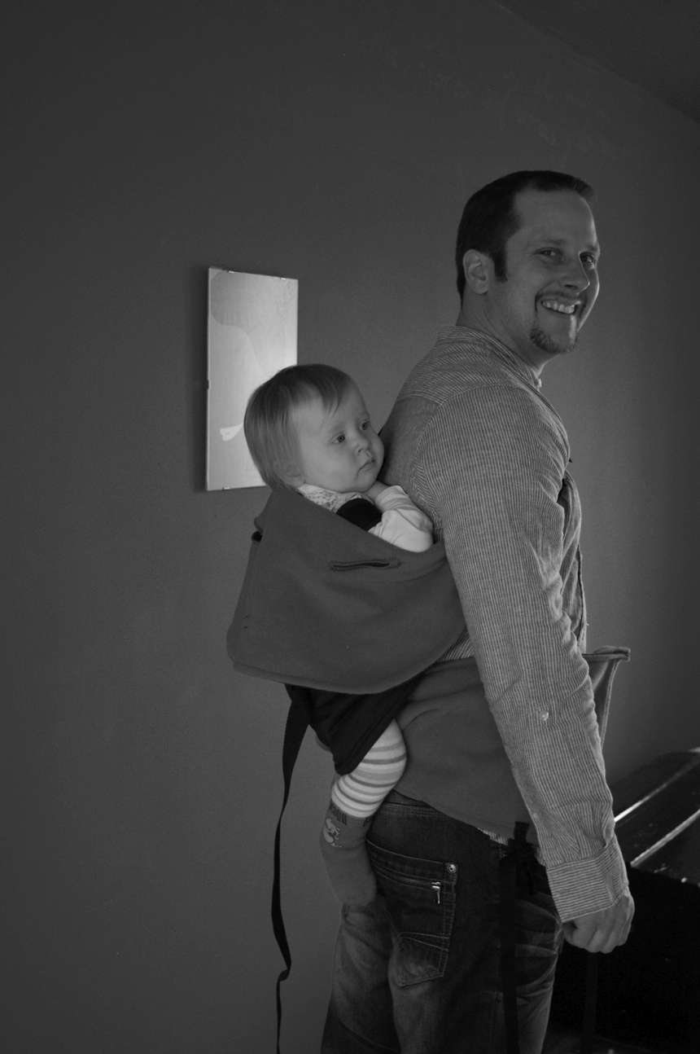
Kigo

Slide 2
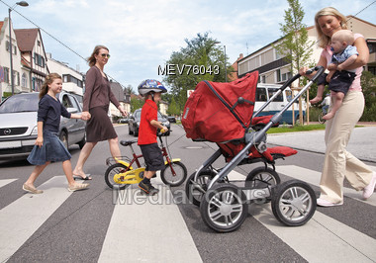
audrey@pamaci.com www.pamaci.com
This concept is born because of a personal frustration of not finding a product easy to use.

Slide 3
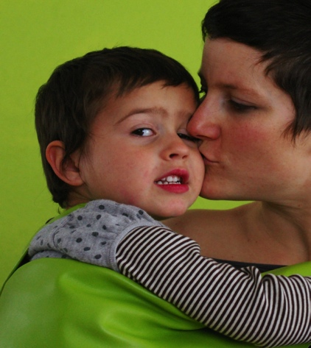
audrey@pamaci.com www.pamaci.com
COMFORT
SECURITY
MOBILITY
LIGHTNESS
  Go to market with my child and that my stroller can support the weight of 25 kg without balancing and get in danger my baby.
  Go for a path in carrying him against my body without getting backache.
  Carry my child (car->stroller->carrying) in total security without waking him up.

Slide 4
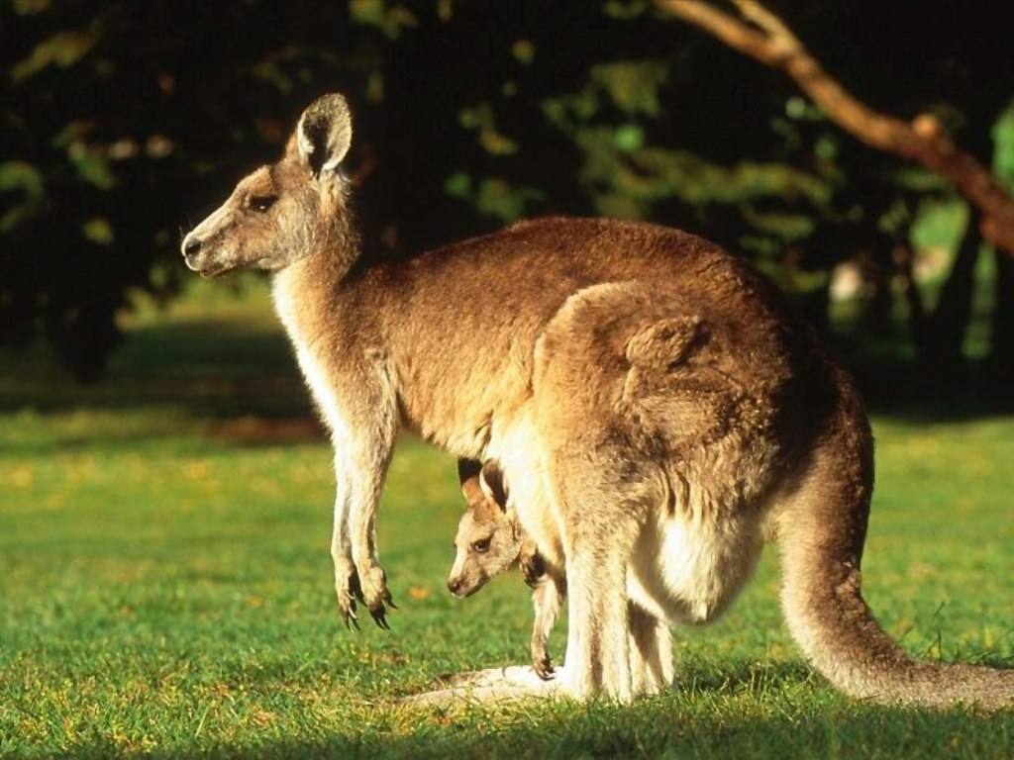
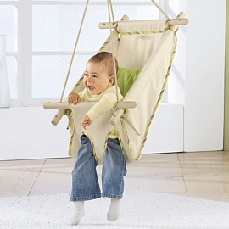
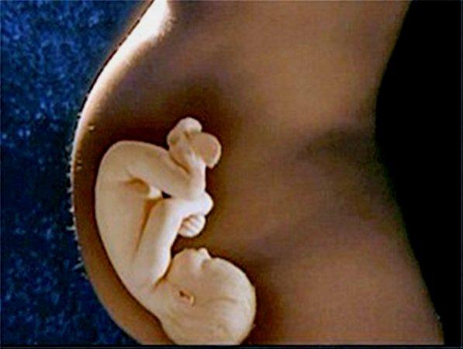
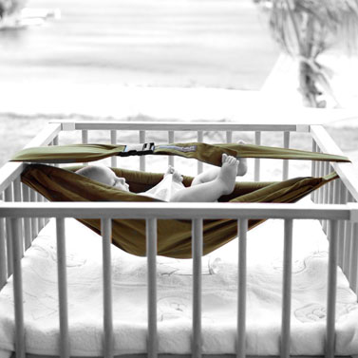
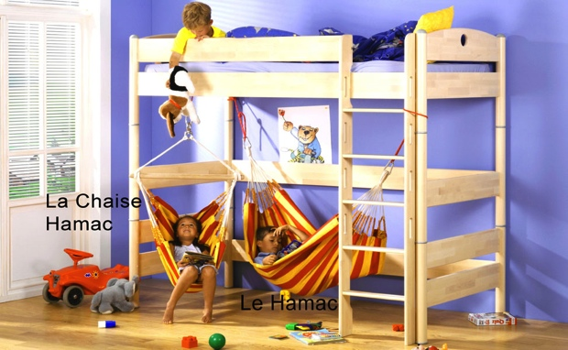
audrey@pamaci.com www.pamaci.com
Keep the feeling of « amortizing gravity ».
Flexibility of the hammock distribute the weight > comfort.

Slide 5
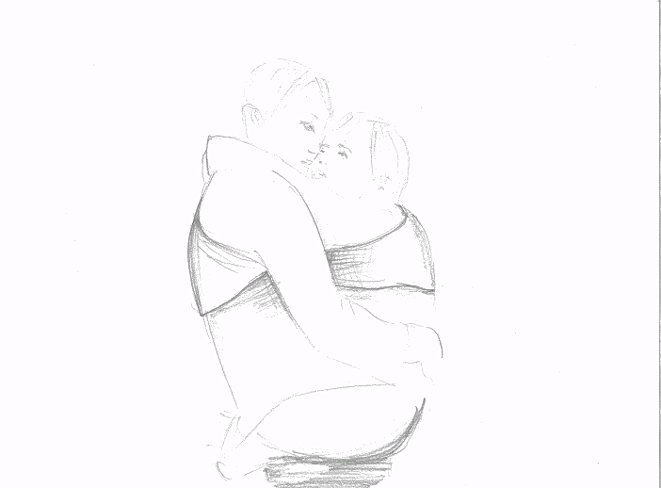
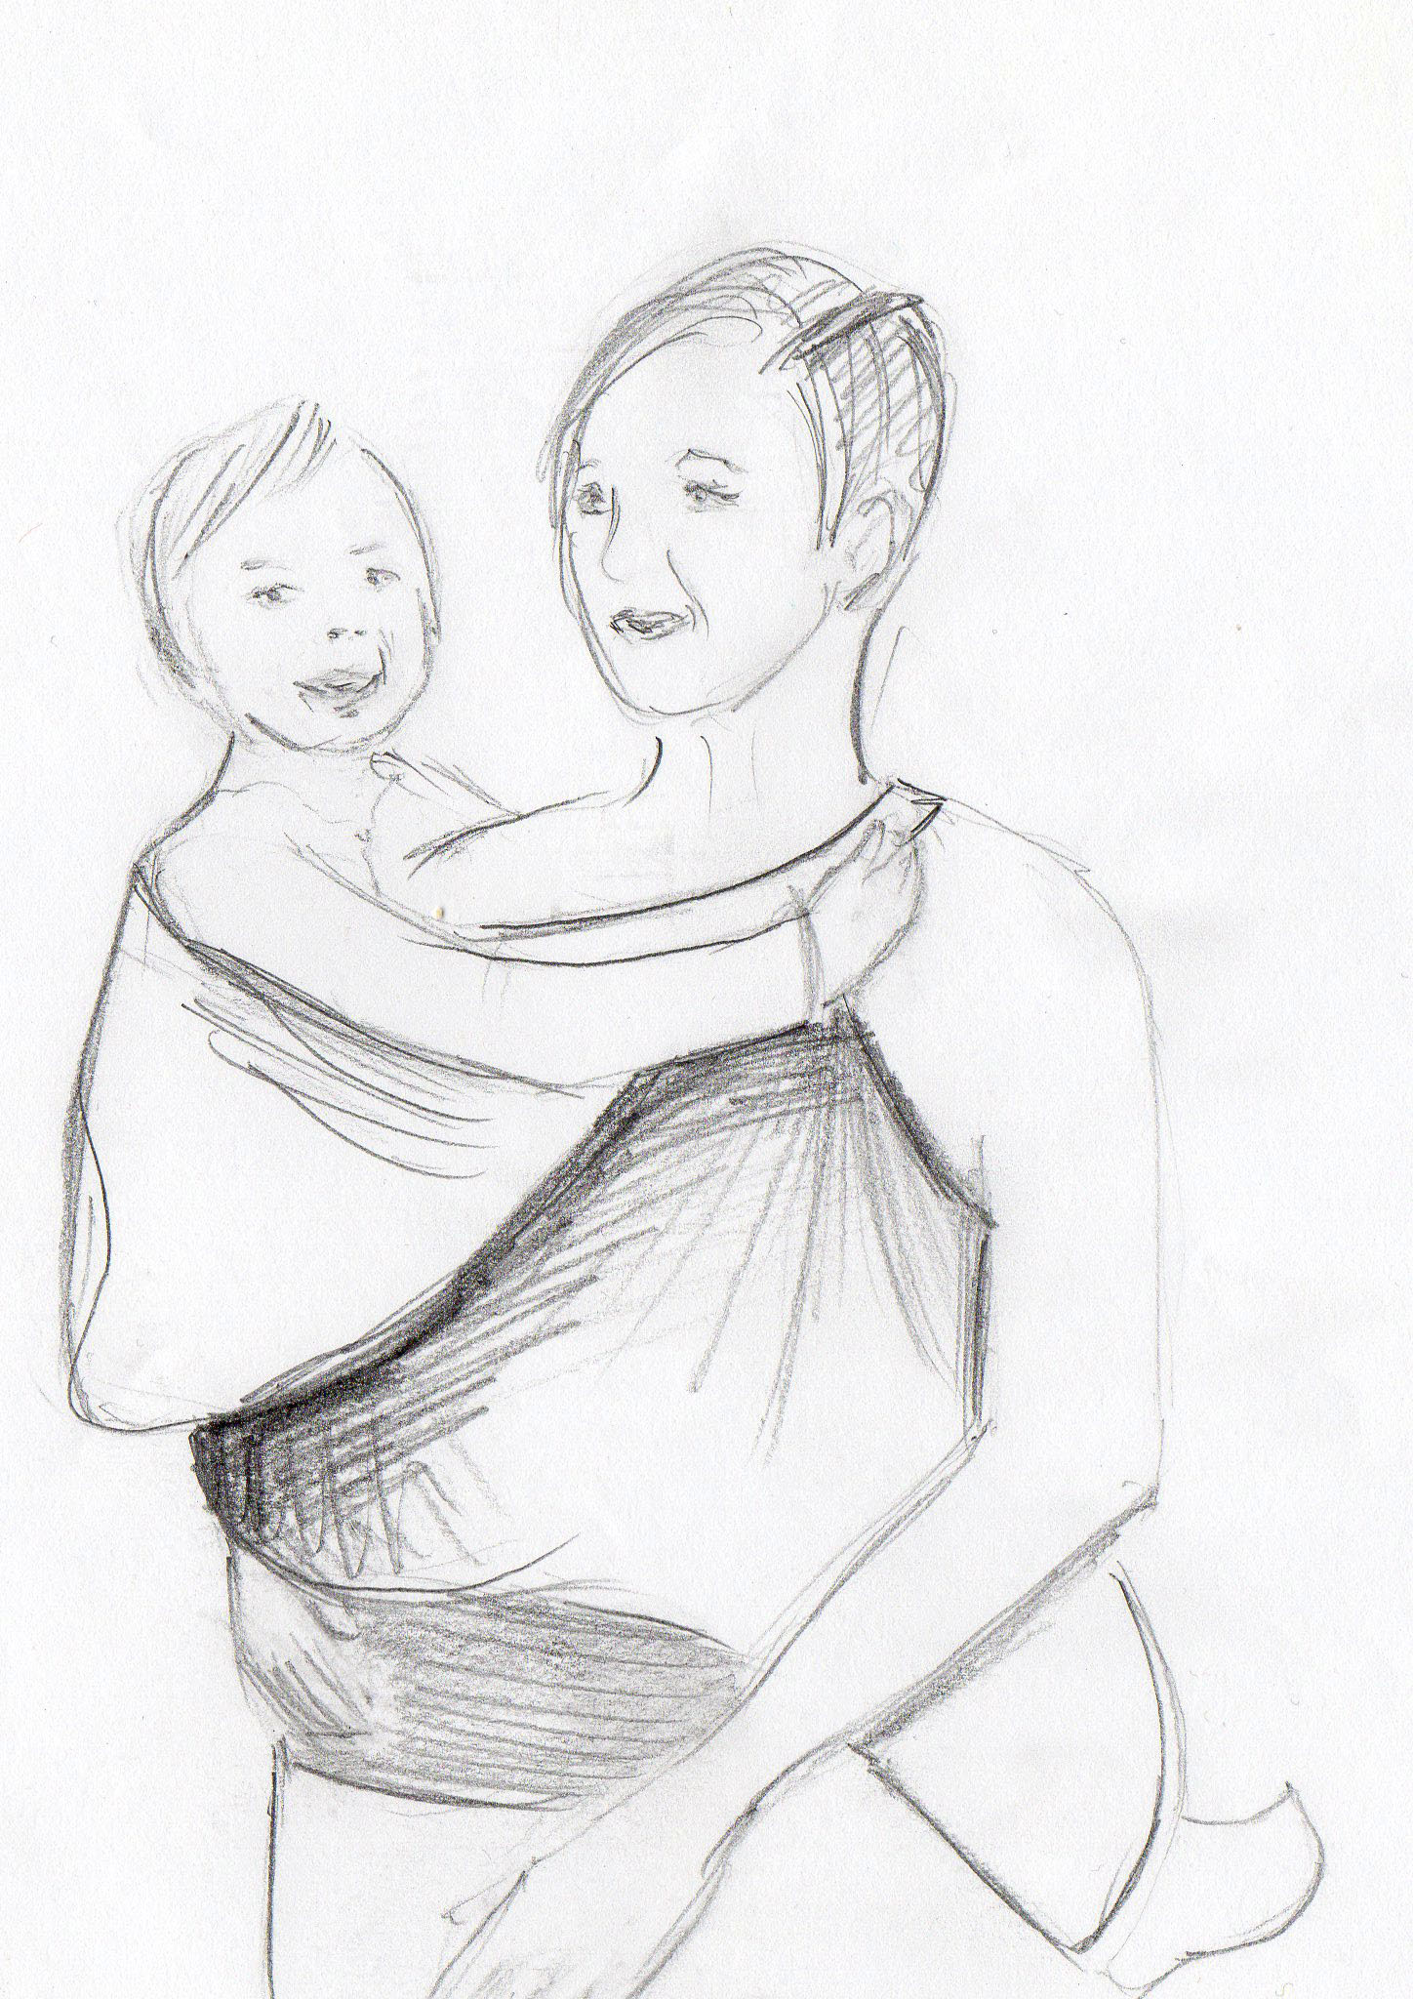
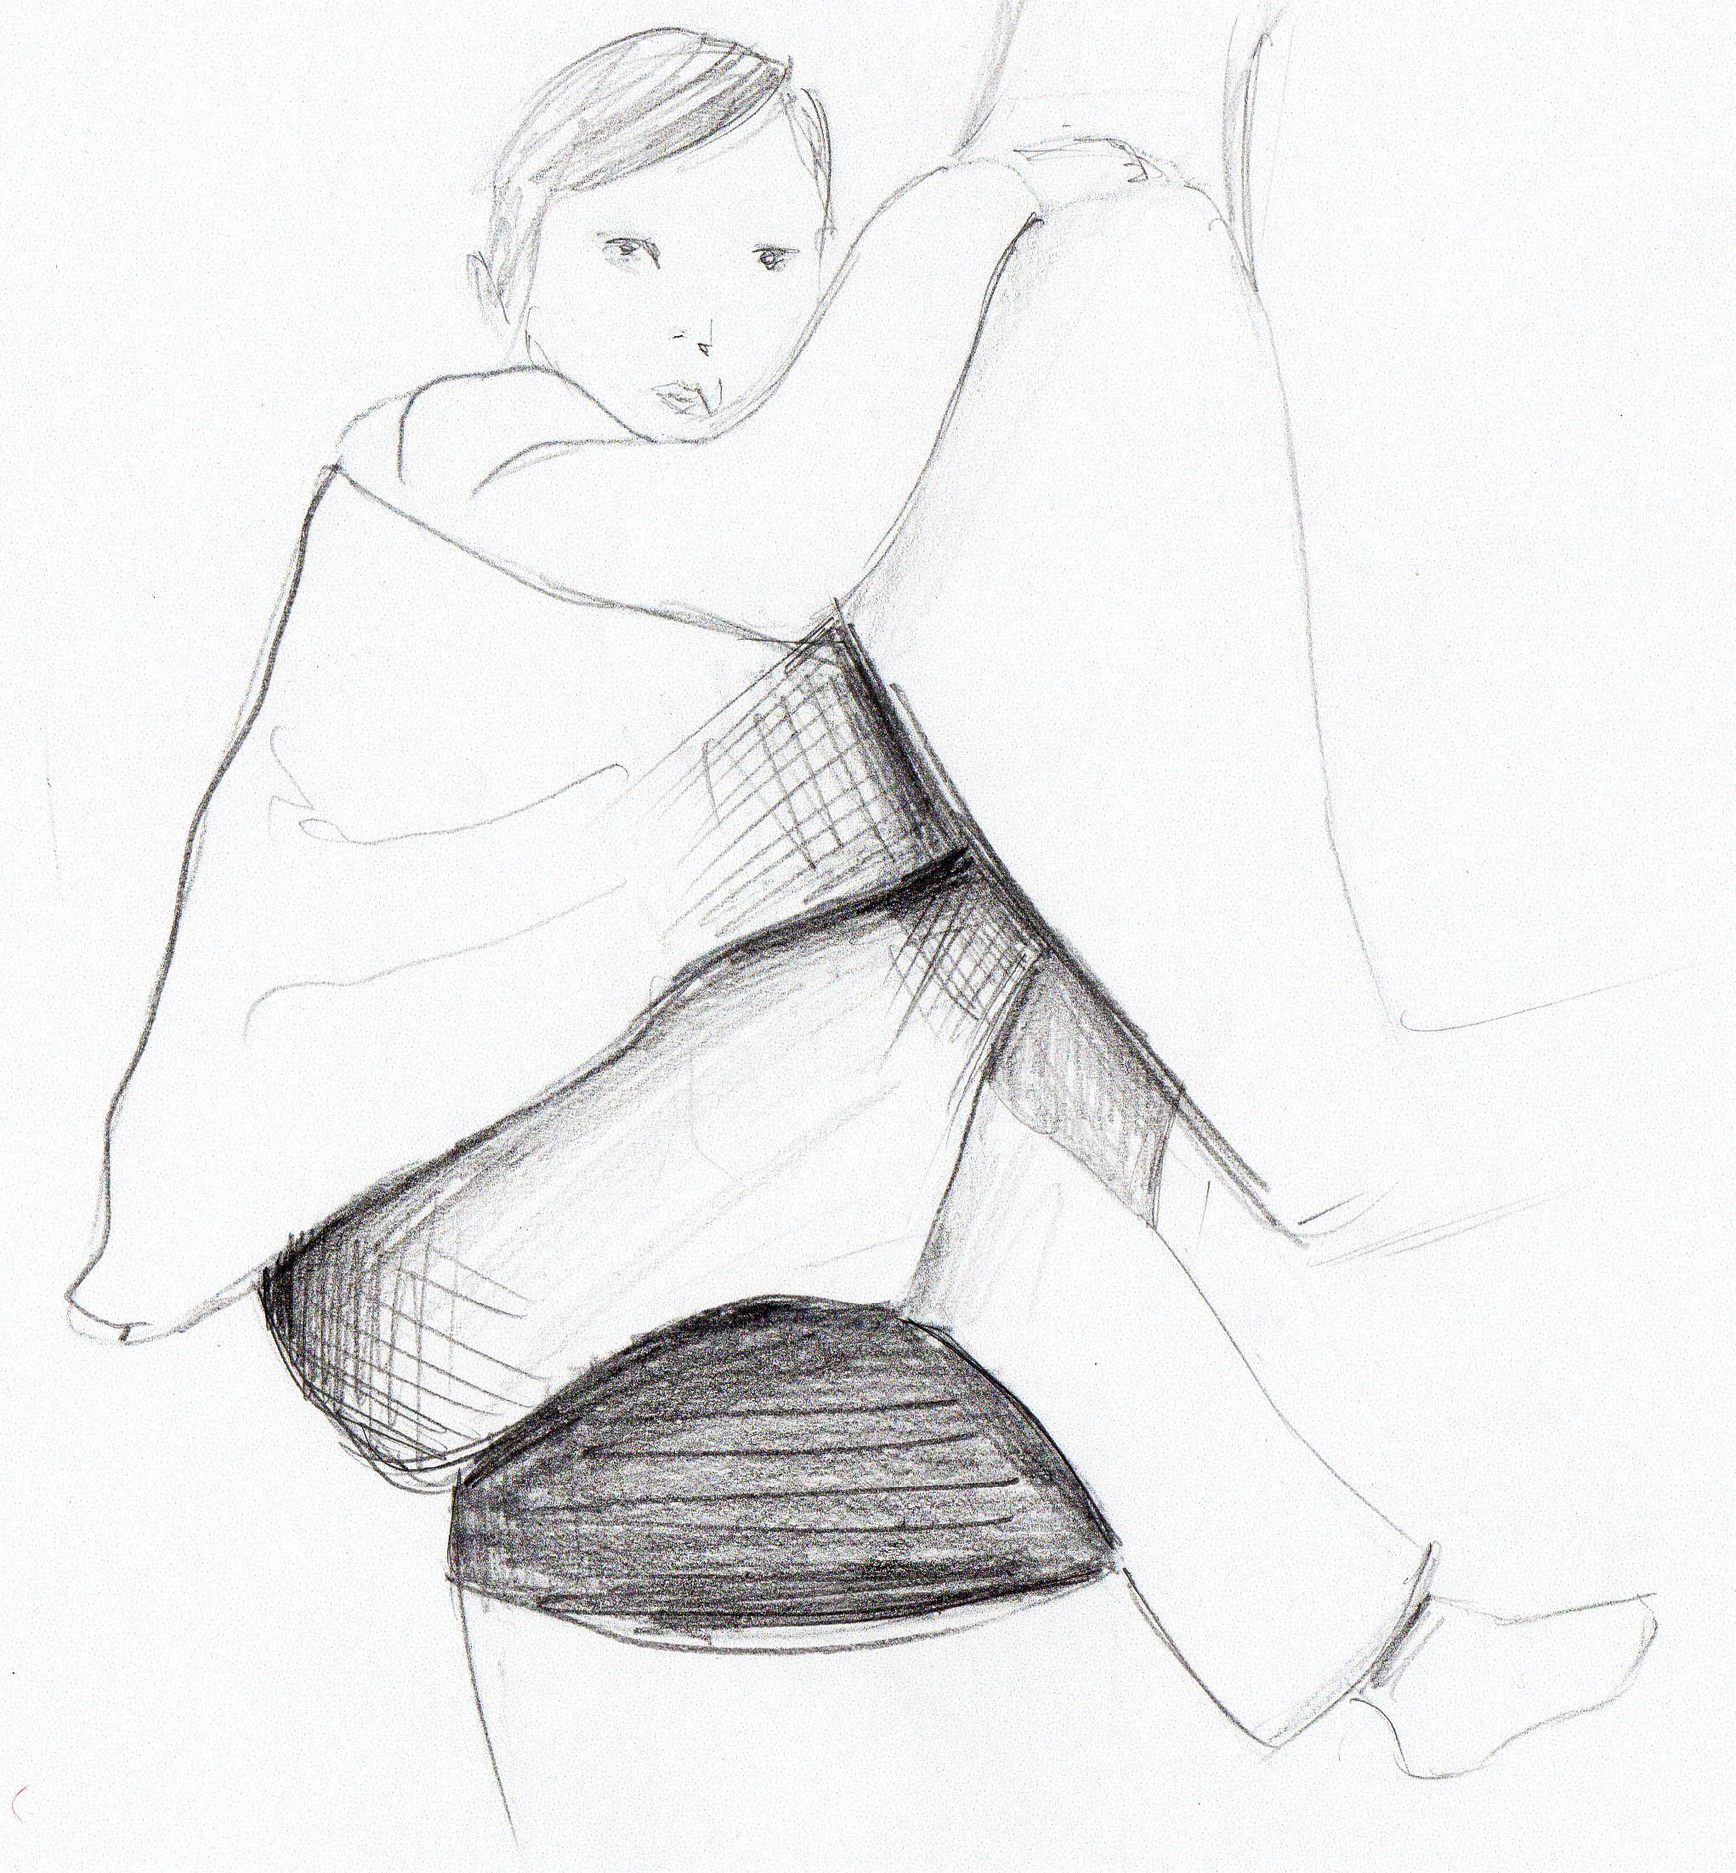
audrey@pamaci.com www.pamaci.com
front
Comfort means changing postures.
You can easily change the position of carrying (front, side, back) so the pressure points are not always the same.
The body of the child is also supported by a large surface of leather or tissue (especially between the legs).
Washable and possibility to add fur in winter.
The security belt is locked once at the back of the child in the way of not waking him up or playing to lock out !
side
back

Slide 6
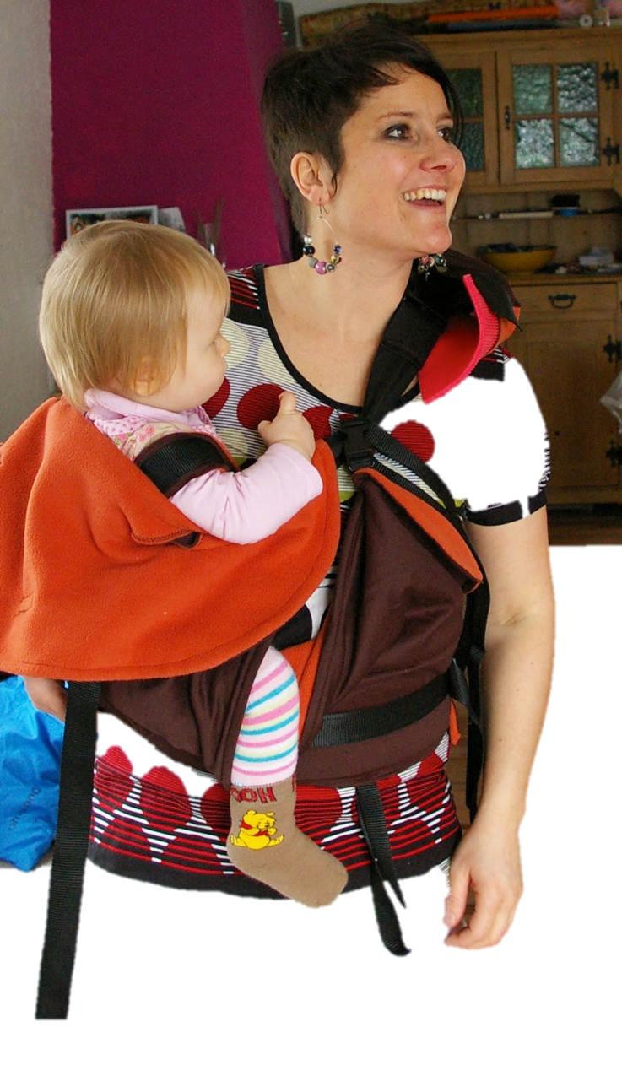
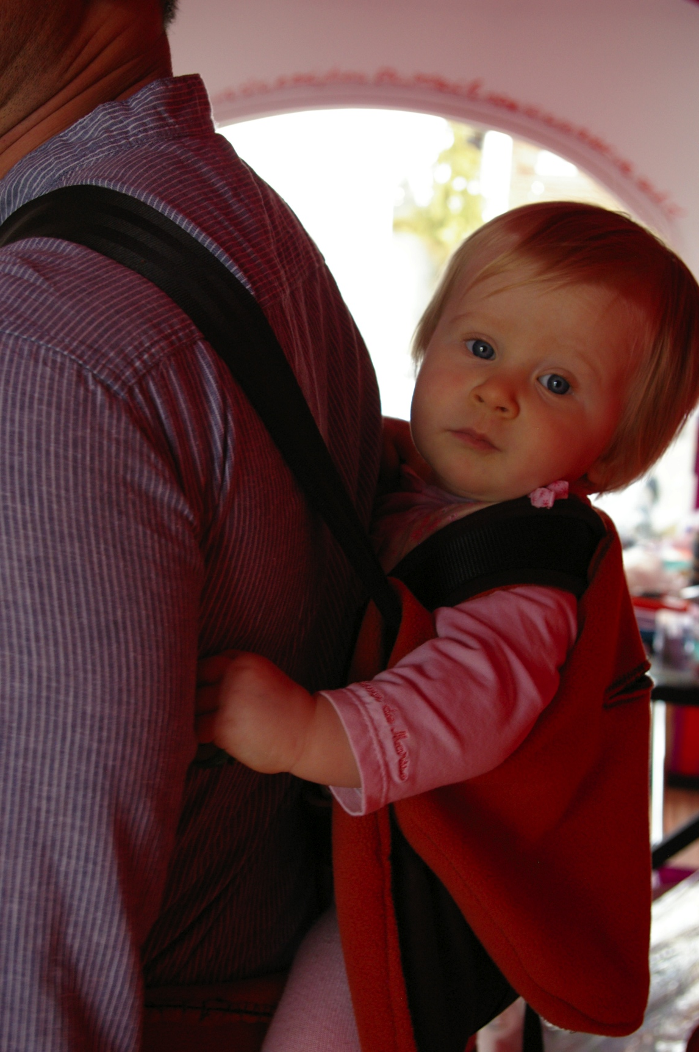
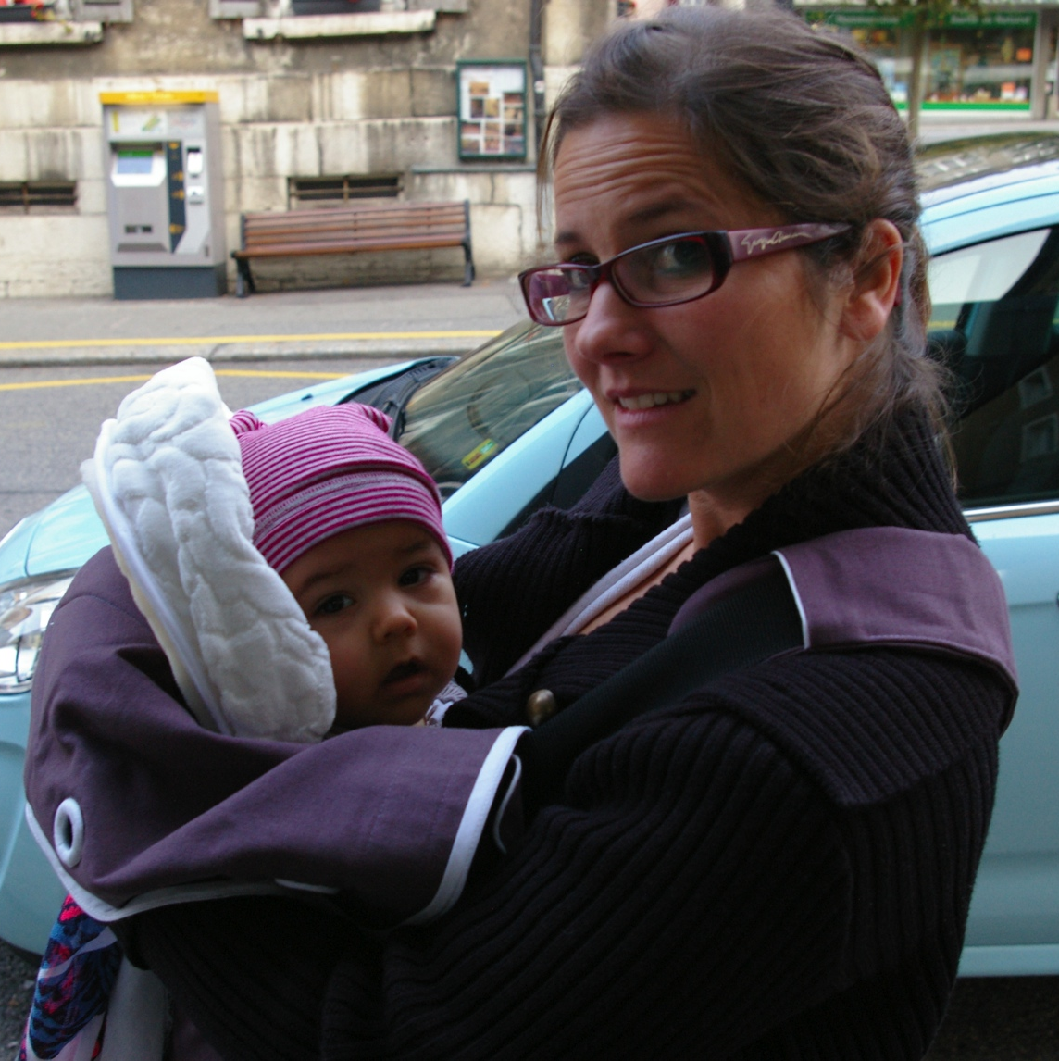
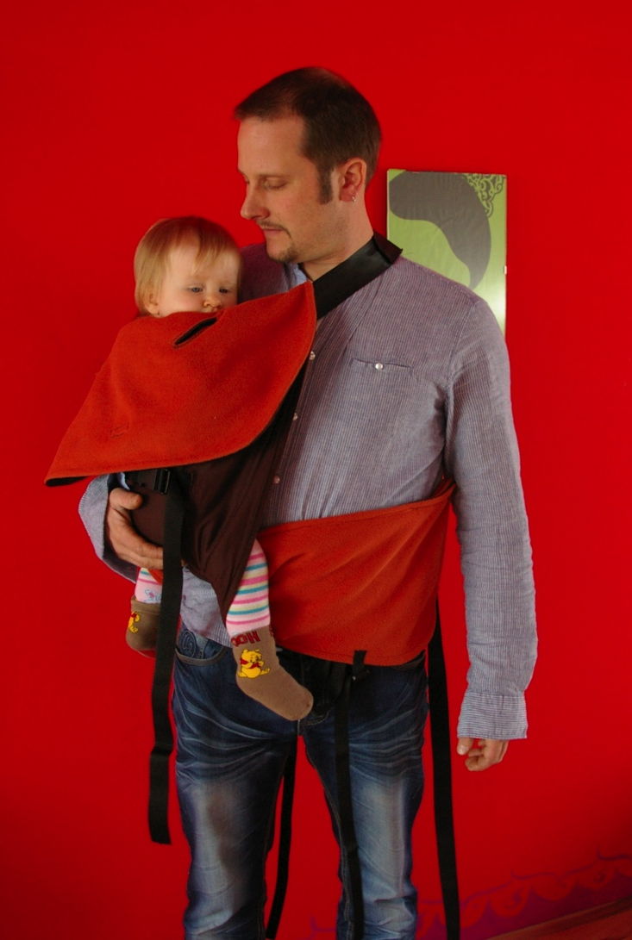
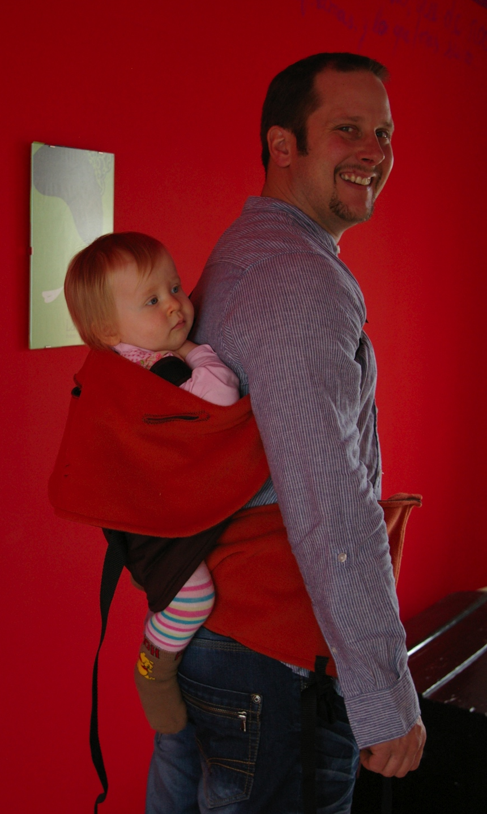
Front
Side
Back

Slide 7
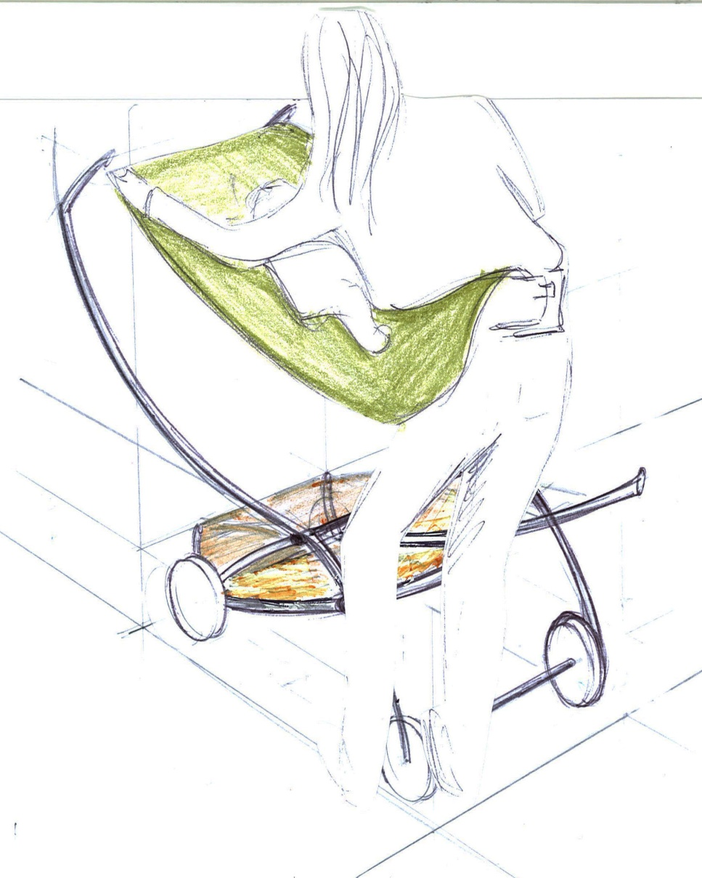
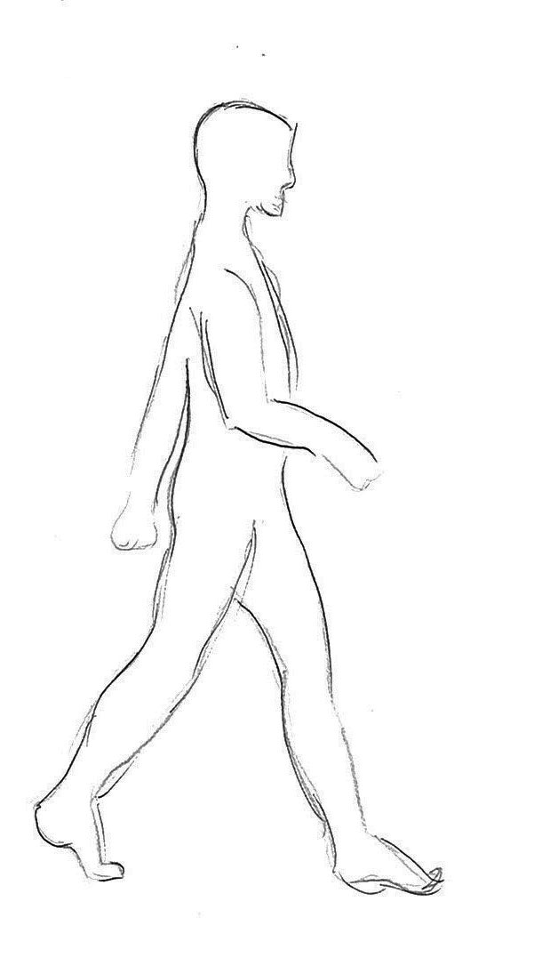
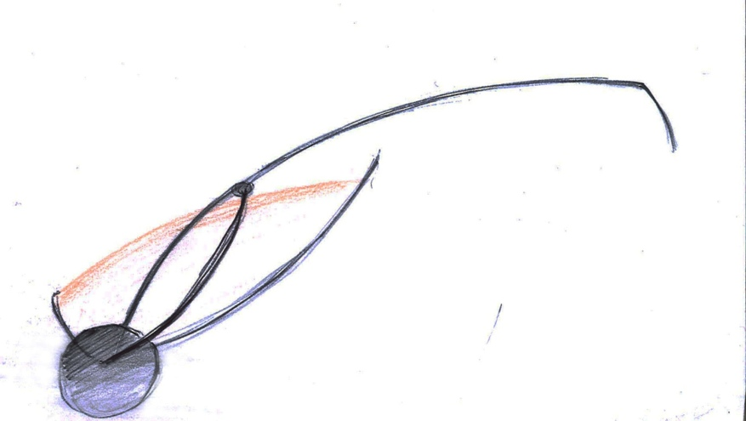
audrey@pamaci.com www.pamaci.com

Slide 8
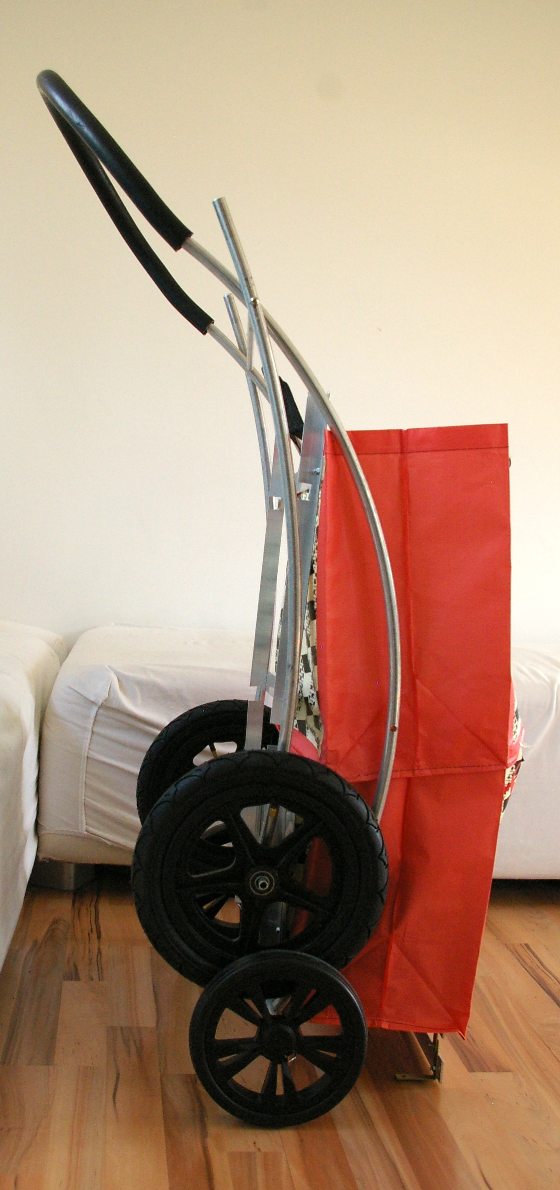
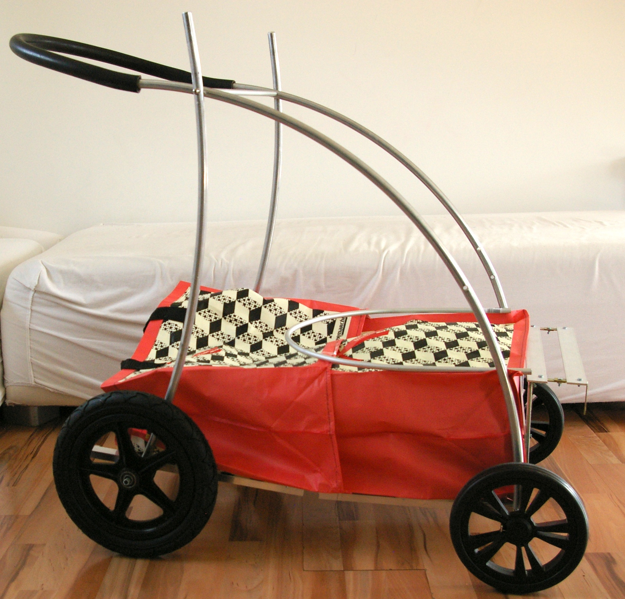
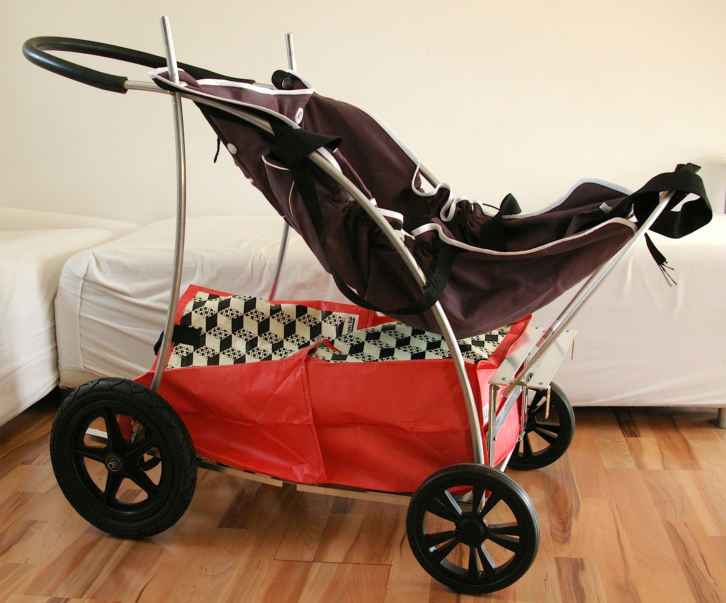

Slide 9
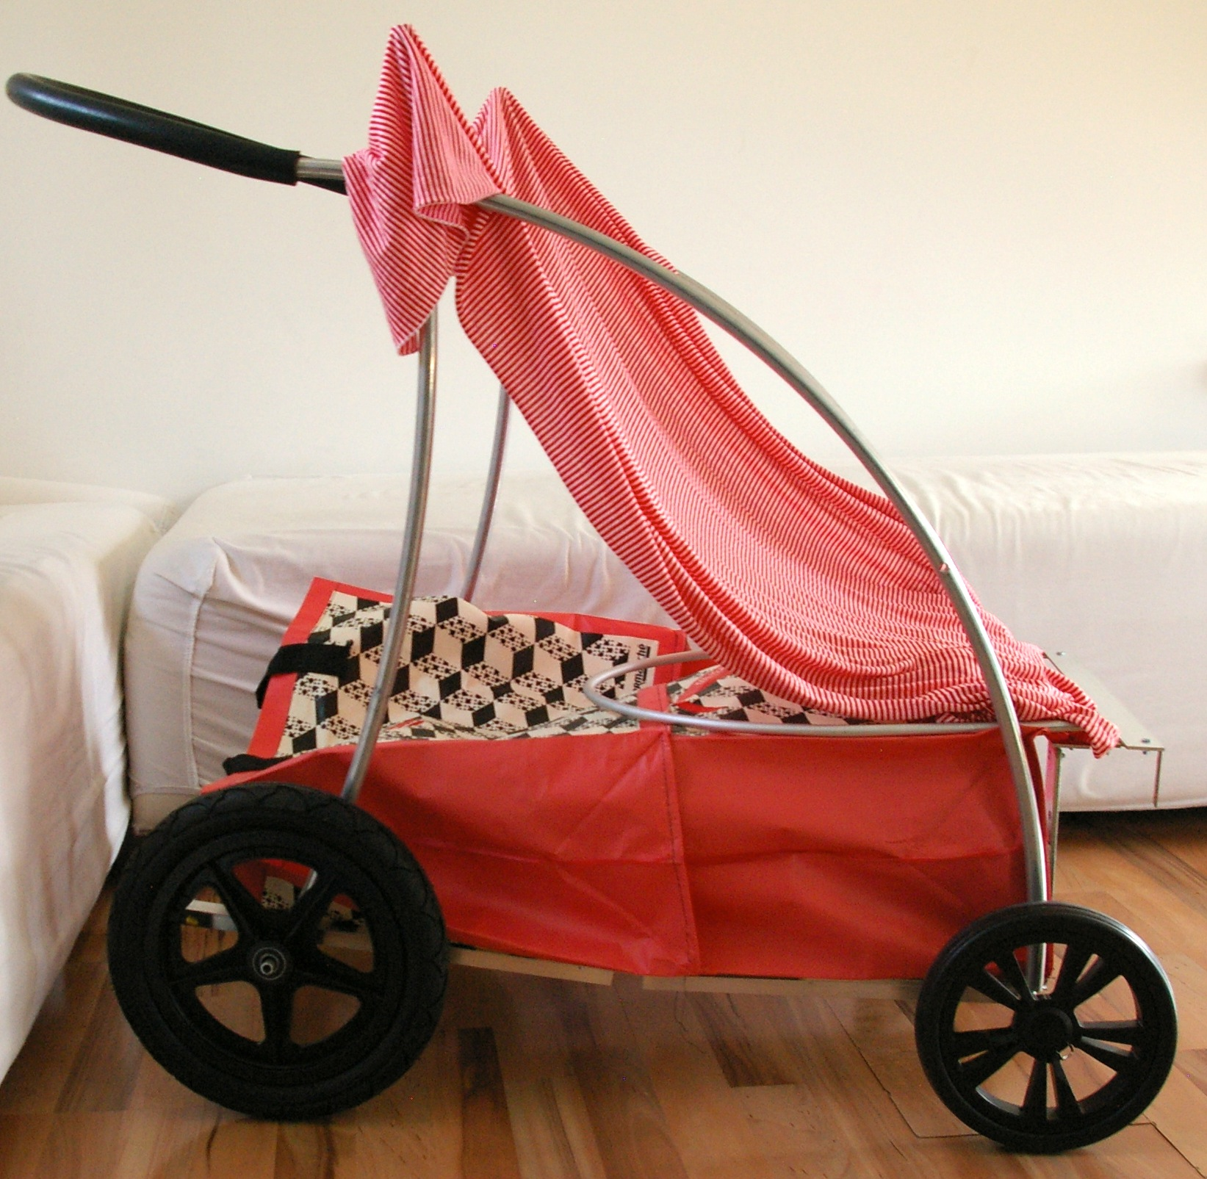
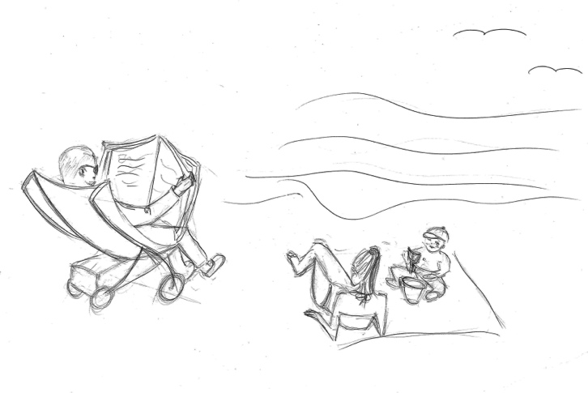
Caddy-seat
(bbq, festivals, beach…)

Slide 10
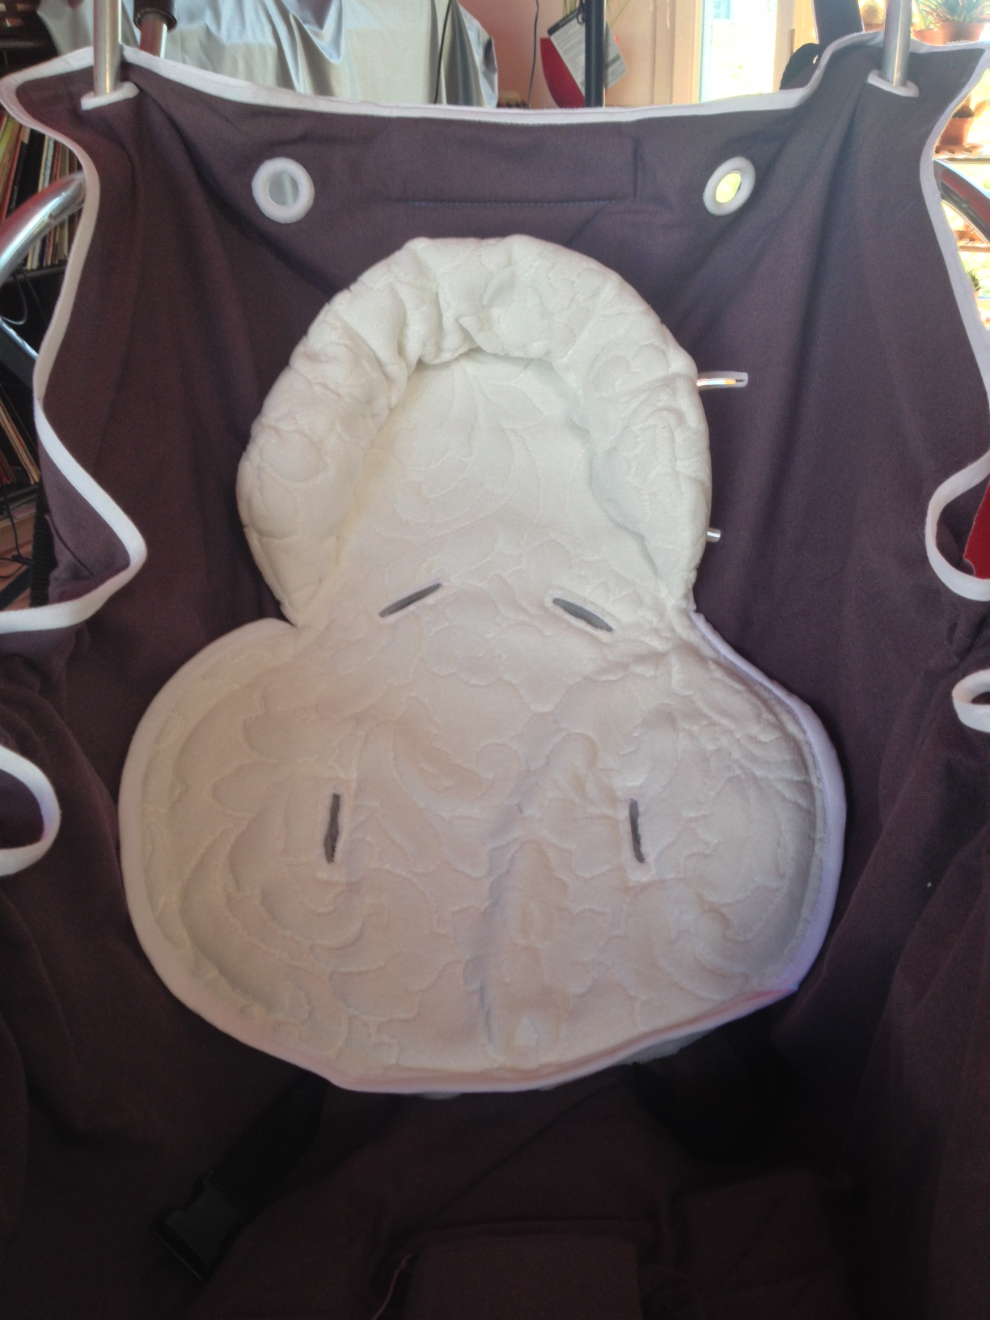
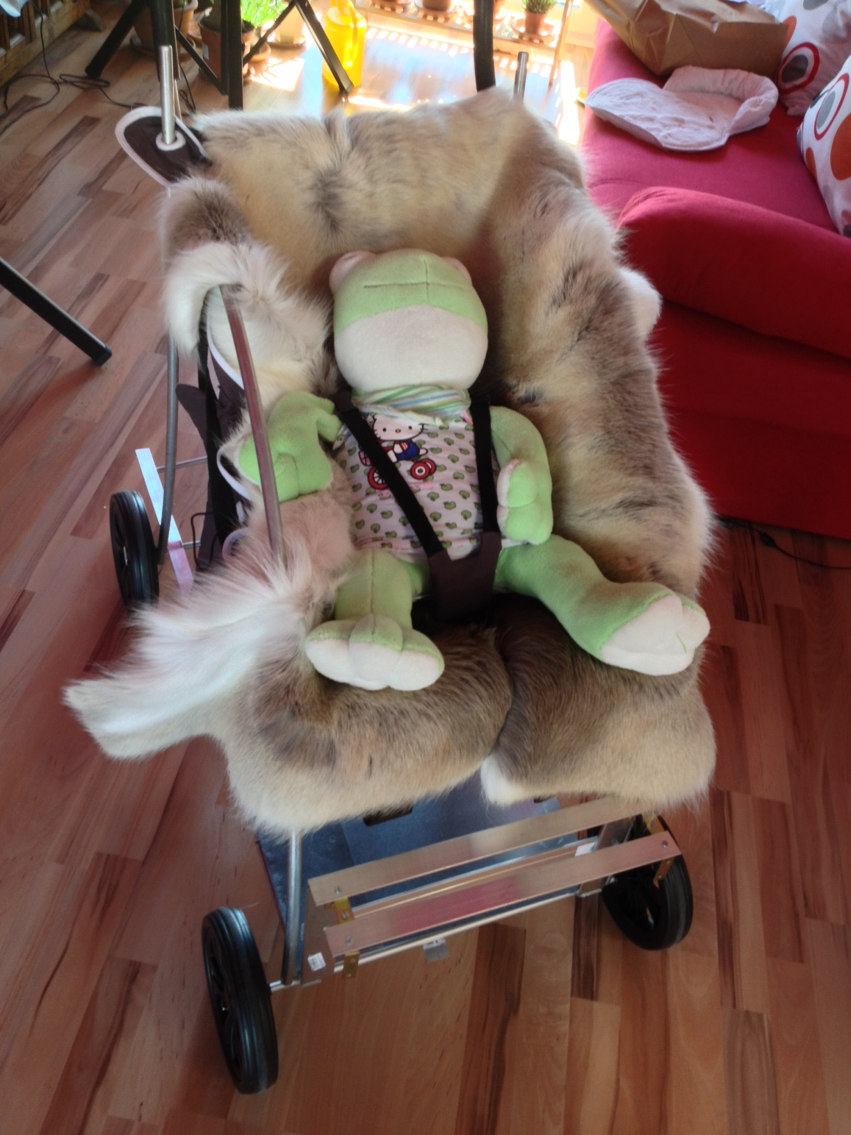
summer
Winter

Slide 11
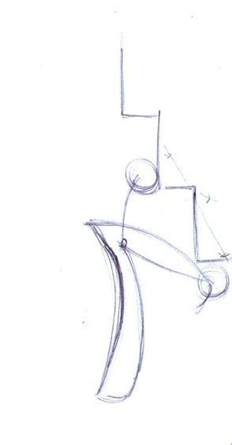
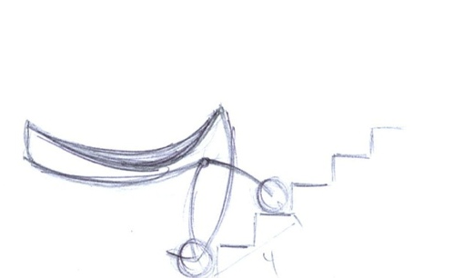
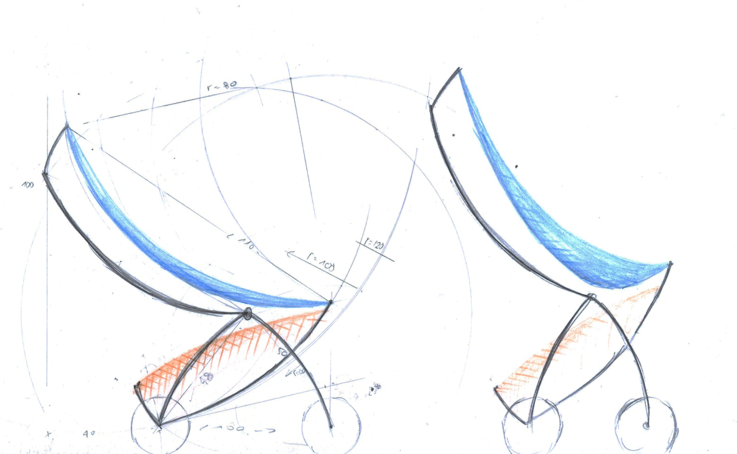
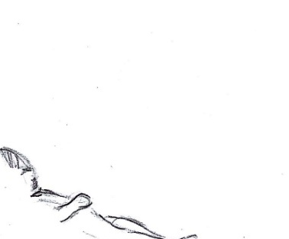
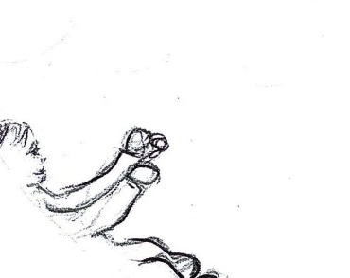
audrey@pamaci.com www.pamaci.com
From sleep to sitting position or to pass every steps!

Slide 12
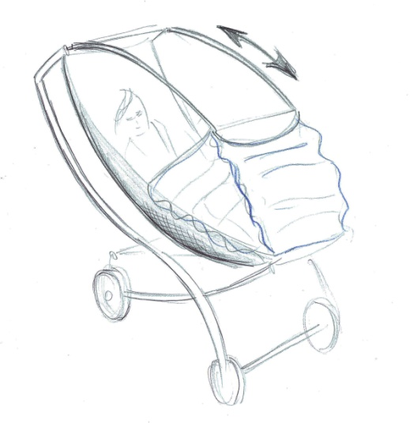
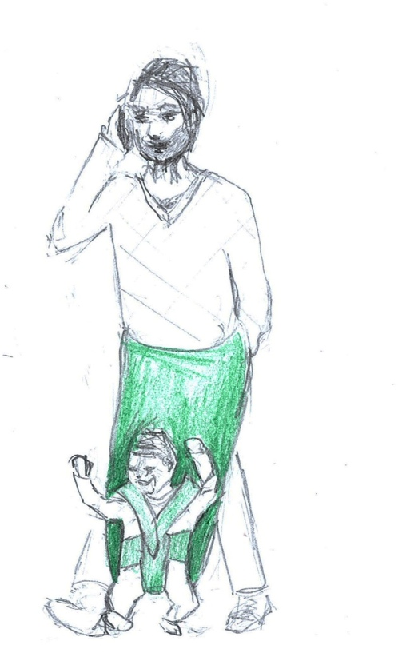
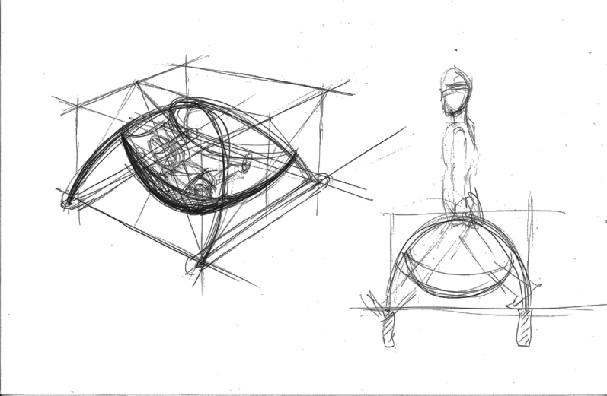
audrey@pamaci.com www.pamaci.com
Why not ?

Slide 13




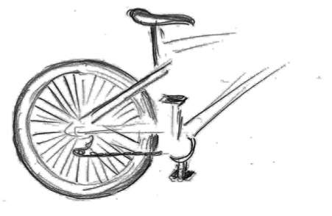
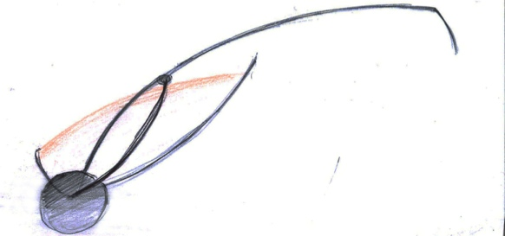
audrey@pamaci.com www.pamaci.com

Slide 14
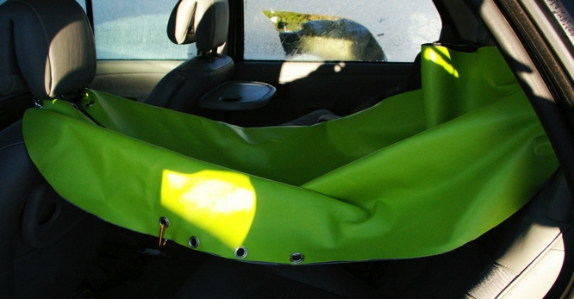
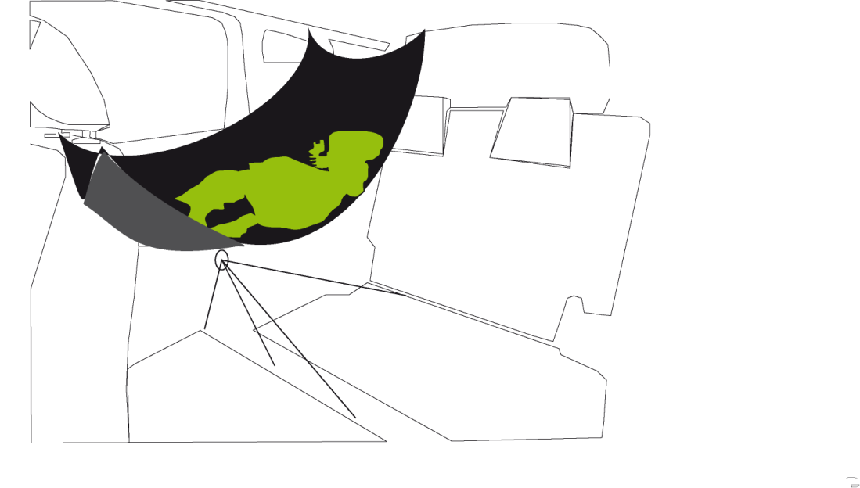
audrey@pamaci.com www.pamaci.com
The advantage of the hammock is that he absorbs more shock
than the car-seat. (the brain doesn’t hit the skull)
If the child is comfortable, less crying, less tension
and less inattention of the parents, so less risk of accident !
The rail system on the roof can slide the sitting to lying position.
Thanks to the back-lock system, the children can not open himself
the security belt.

